Slide 1
Automating Software Installs with Powershell
Adam bertram

Slide 2
PS> whoami
Senior Microsoft Systems Consultant
Lots of Powershell
System Center (SCCM and SCOM)
Blogger – adamtheautomator.com
Pluralsight and Udemy Online Course Author
Freelance Writer
Twitterer - @adbertram

Slide 3
My Struggle with Software Installs
Add/Change registry keys after install in both HKLM and HKCU
Copy N files to directories X, Y and Z after install
Ensure software XYZ isn’t running before installing
Create a shortcut to software after install named Foo
Import this certificate
Learn each installer’s silent install nuances
…and on and on and on

Slide 4
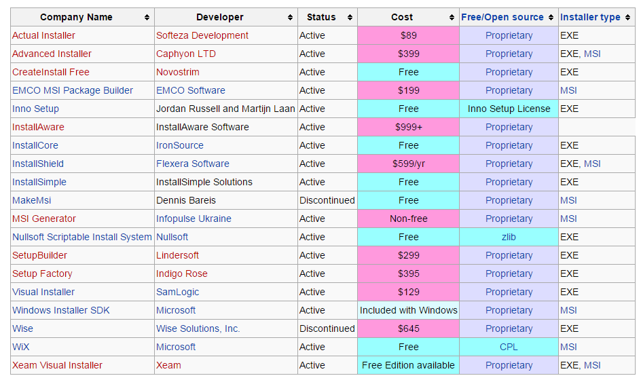
Install Technologies

Slide 5
A Typical Process For a Software Deployment
Install manually to discover the prompts
Figure out the switches for a silent install
Run the silent install
Test the install with the app owner
Write a script to account for 1,521 extra things
Test, test and test again

Slide 6
Mass Deployment Install with Powershell
Gather any extra steps from app owner
Manually install just to make sure it works
Install-Software
Test the install with the app owner

Slide 7

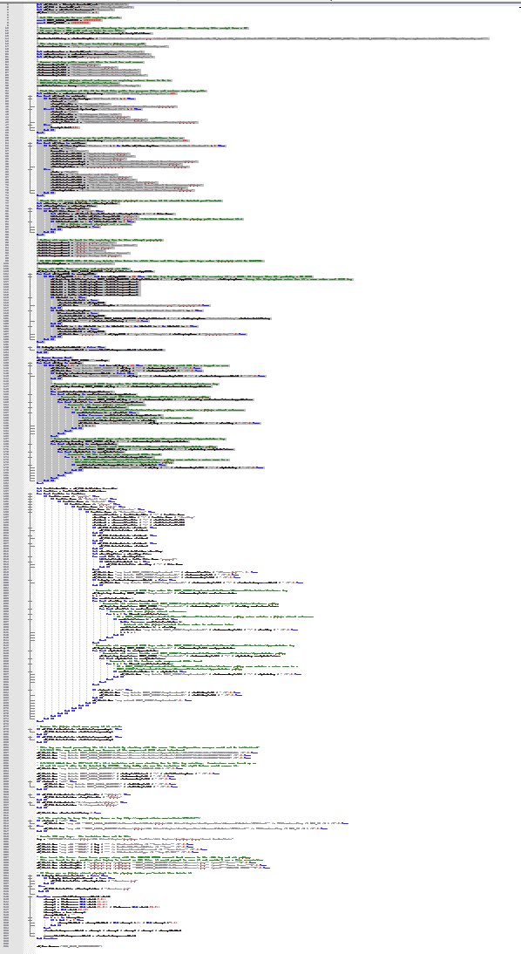
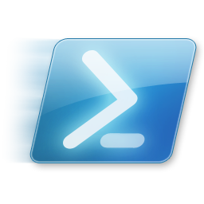
My Evolution of Software Deployments
Error?
Fix it
Not included?
Automate it

Slide 8
Demo – How I Do Software Installs

Slide 9

Github – Download and Contribute
https://github.com/adbertram/SoftwareInstallManager

